Slide 1

Exploring Interim Assessment Blocks as a Team
Quiana Hennigan
Assessment & Research Department
Everett Public Schools
Updated 12/14/2021

Slide 2
Objectives
Understand:
the role of Interim Assessment Blocks (IAB) in the Smarter Balanced Assessment (SBA) system
how to explore the IAB blueprints and item specifications as collegial work and to select an appropriate IAB
how to prepare students for and administer IABs
how to review IAB scores and use them inform instruction

Slide 3
Smarter Balanced Assessment System
Summative Assessment
Teachers and schools have information and tools they need to improve teaching and learning
Common Core State Standards specify
K-12 expectations for college and career readiness
All students leave
high school college
and career ready
Digital Library
Interim Assessments

Slide 4
Interim Assessment Types
Interim Assessment
Interim Comprehensive Assessment (ICA)
Interim Assessment Blocks (IAB) &
Focused Interim Assessment Blocks (Focused IAB)
Mirrors summative SBA in structure, content and time for a grade level and content area.
Smaller assessment focused on a more narrow set of standards for a grade level and content area.
Notes:
There are two components to the Interim Assessments Comprehensive and Blocks.
Comprehensive, mirrors summative Smarter Balanced Assessments.
Whereas, Blocks are smaller assessments focused on a more narrow set of standards.
Interims are voluntary to administer. They can be used to guide instruction or inform about student learning.
Last year you didn’t know what was on the interims or what the scores meant: below, at or near, above.
This year, there is a process that we will be discussing that allows you to view the assessments and determine which assessments will better aid current curriculum lessons and also allow you to see the structure of questions.

Slide 5
Why should I use an IAB?
Assess student learning against a set of standards
Get actionable data to inform instruction
Evaluate growth in a unit of study
Provide students experience in the online assessment environment in preparation for the summative assessment
Provide students experience with questions and tasks using structures aligned with the summative assessment

Slide 6
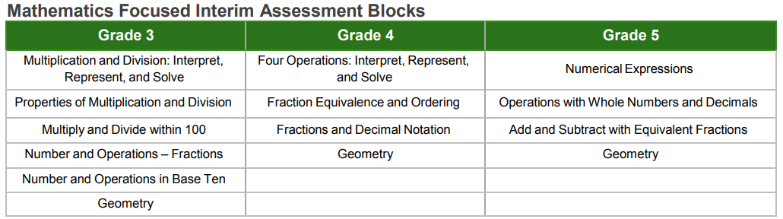
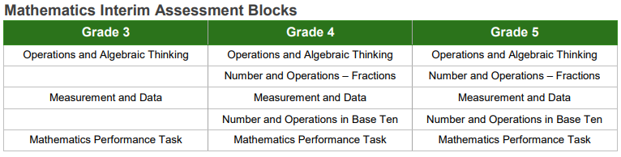
IABs for Mathematics: 3-5

Slide 7
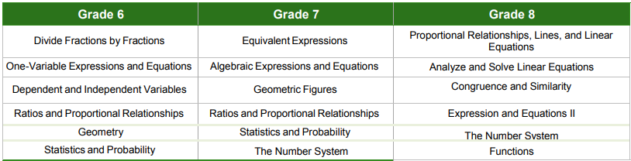
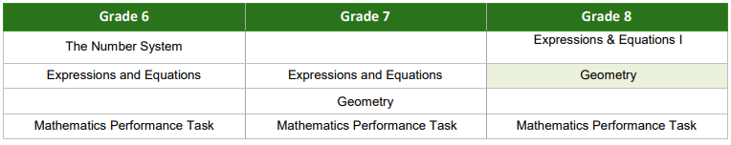
IABs for Mathematics: 6-8

Slide 8
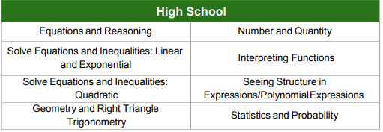
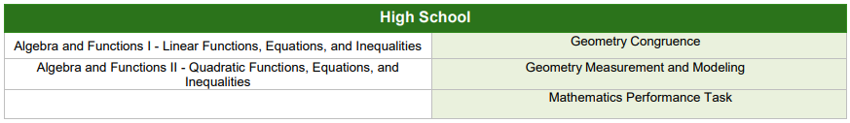
IABs for Mathematics: High School

Slide 9
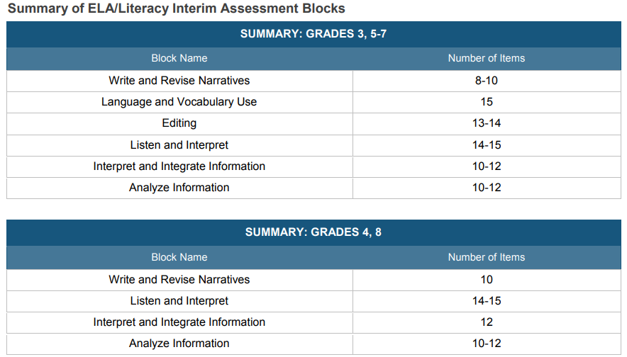
Focused IABs for ELA: 3-8

Slide 10
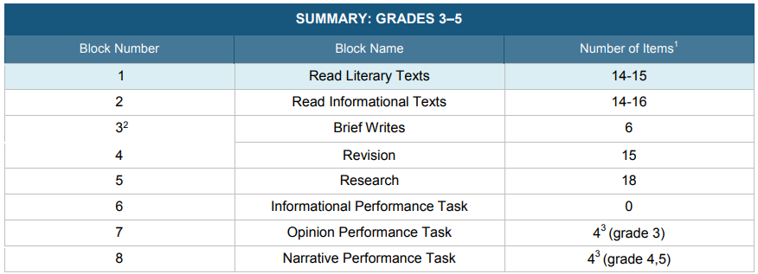
IABs for ELA: 3-5

Slide 11
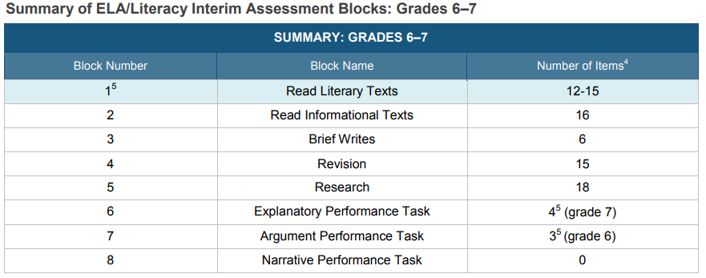
IABs for ELA: 6-7

Slide 12
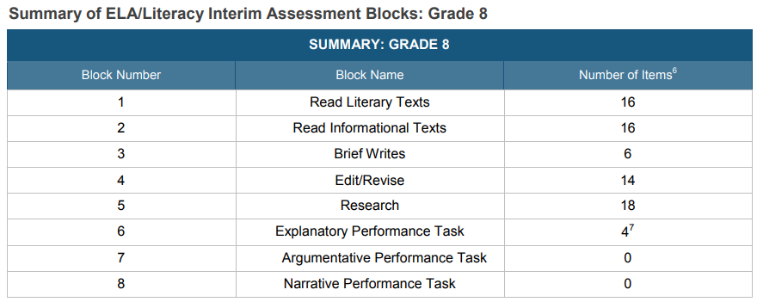
IABs for ELA: 8

Slide 13
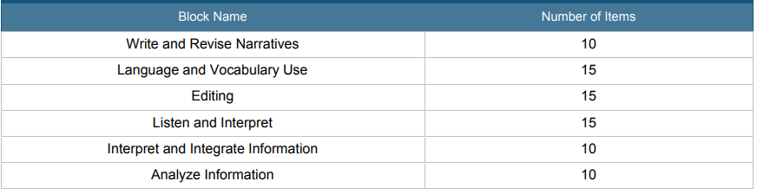
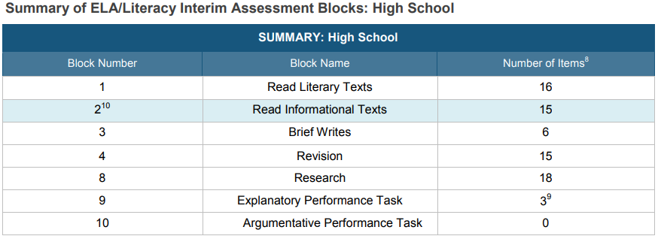
IABs for ELA: High School
Focused Interim Assessment Blocks
Interim Assessment Blocks
Focused Interim Assessment Blocks
Interim Assessment Blocks

Slide 14
Selecting an IAB
Collaborate with team and specialists to select an IAB:
Consider the purpose: what do you hope to learn?
What fits the instructional map?
Review the Test Blueprints
  Consider content, structure and DOK
Take the IAB using the Assessment Viewing Application (AVA)
  Consider content, item format, ease of use of tools/items

Slide 15
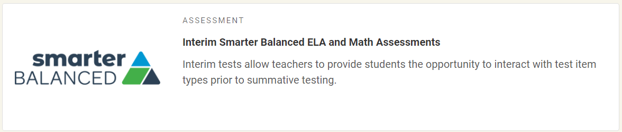
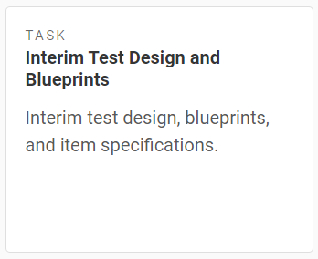
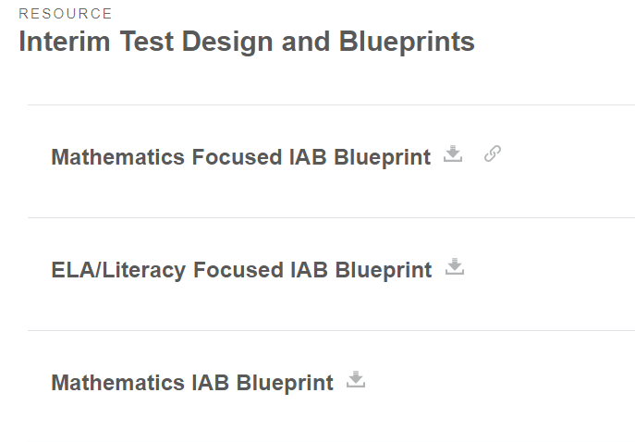
Finding Blueprints in WCAP Portal
1. Go to WCAP Portal through Managed Bookmarks.
2. Click on the blueprints task tile.
3. Click to download the relevant blueprint.

Slide 16
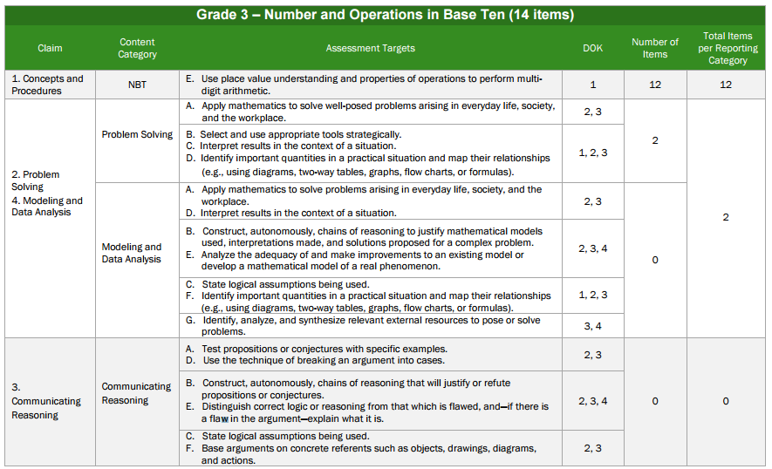
IAB Blueprints

Slide 17
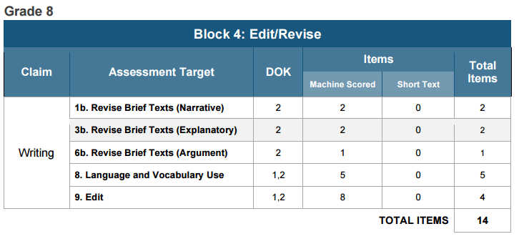
IAB Blueprints

Slide 18
IAB Blueprints
G3_
1E_
NBT_

Slide 19
IAB Blueprints
G08
C 2_
T1.b
Claim 1: Reading
Claim 2: Writing
Claim 3: Speaking and Listening
Claim4: Research

Slide 20
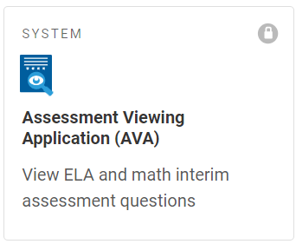
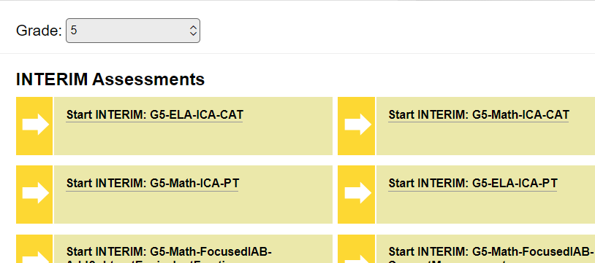
Assessment Viewing Application (AVA)
1. Go to WCAP Portal through Managed Bookmarks.
2. Scroll down and click on the AVA system tile. Log in.
3. Select the grade level and click on the interim you want to view.

Slide 21
How do I prepare for an IAB?
Check your roster and accommodations.
  Contact your TIDE manager for help if:
    you are missing students or have extras
    you think a student’s accommodations are wrong in any way
    You need guidance on providing an accommodation or support
Provide a *guided* training/practice test:
  Provides opportunities for students to:
    practice logging in
    be trained in the use of their tools, supports, and accommodations
    be trained in the use of the item types they will see in interim and summative testing

Slide 22
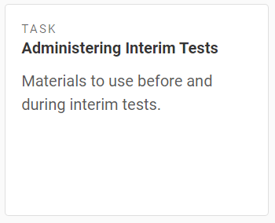
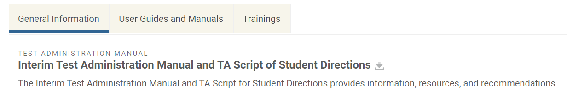
How do I administer an IAB?
Use Interim Administration Manual
Gather:
  Test tickets
  Support/accommodation materials
  Scratch paper if required
Use the instructions in the Manual to lead students into the Secure Portal to take the assessment.

Slide 23
How do I administer an IAB at home?
In advance: provide each student with their SSID and first name (exactly as shown on your roster
  SSID is FERPA protected
Use Interim Administration Manual
Launch session in TA Interface
Use Zoom to proctor the session.
  Many teachers use individual breakout rooms
Students log in at a special site to allow them to access the test while Zoom is open:
  https://mobile.tds.cambiumast.com/launchpad/

Slide 24
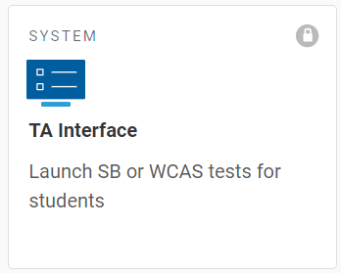
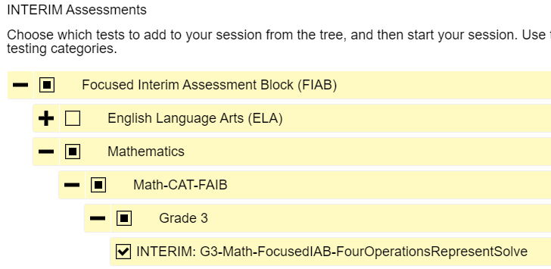
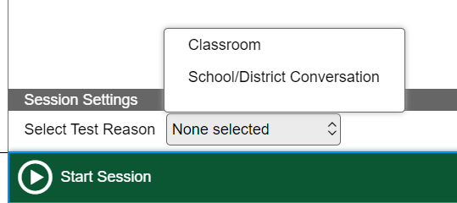
TA Interface: launching a session
WCAP Portal>Interim tile> TA Interface system tile
Select test by clicking +/- to only offer the one test
Pick a Test Reason in advance with your team and select it before clicking start.

Slide 25
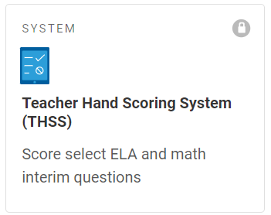
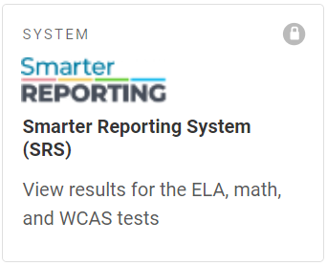
How do I get my student scores?
If IAB includes constructed response
requires hand scoring prior to final score appearing in Smarter Reporting.
Tentative scores will be generated for full writes, but are not equivalent to teacher hand scoring.
If IAB doesn’t include constructed response
scores in shortly after submission.

Slide 26
Teacher Hand Scoring System (THSS)
WCAP Portal>Interim assessment tile>THSS system tile (scroll down)
Instructions are in the back of the Interim Manual.
TIP: make sure to mark your students complete when you are done scoring or their scores will not show up in Smarter Reporting.

Slide 27
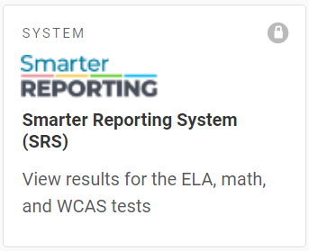
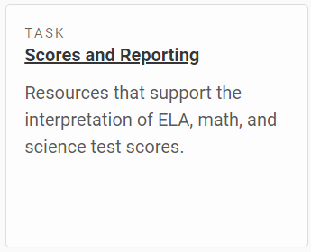
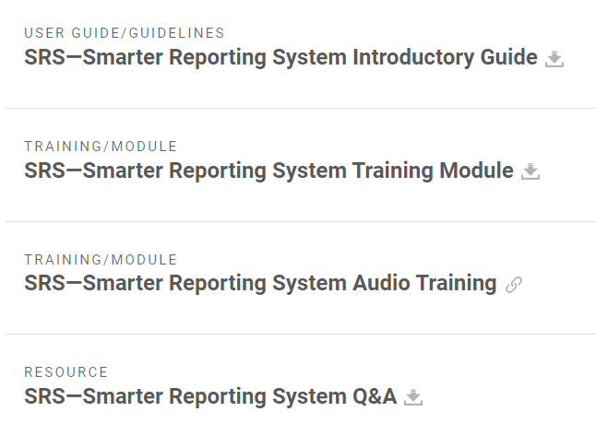
Smarter Reporting System (SRS)
WCAP Portal>Interim assessment tile>SRS system tile (scroll down)
Extensive instructions are available here: WCAP Portal>Interim assessment tile>Scores and Reporting task tile>scroll down to resources

Slide 28
Interim Comprehensives Fun Facts
Comprehensive is as long as a full-length summative SBA
Must complete both CAT and PT for that subject
Must complete hand scoring to get a score

Slide 29
Understanding your scores
Work with content specialists and your team
Review student data as a team
Score hand scoring collaboratively
Why?
  Calibration
  Learning more deeply about standards
  Learning about the structure of questions and tasks
Analyze the results keeping in mind:
  Learning targets students have been exposed to
  Depth of knowledge
  Instructional map
  Question or task construction
  Results of other assessments
  Distractors

Slide 30
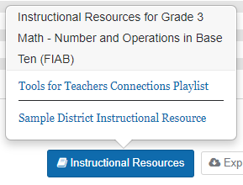
Apply the data to instruction
Click Instructional Resources for Tools for Teachers Resources like Connections Playlists
Work with coaches/facilitators on next steps.
    Protect the Reliability of the Exam
      Don’t review questions with students
      Do develop similar questions

Slide 31
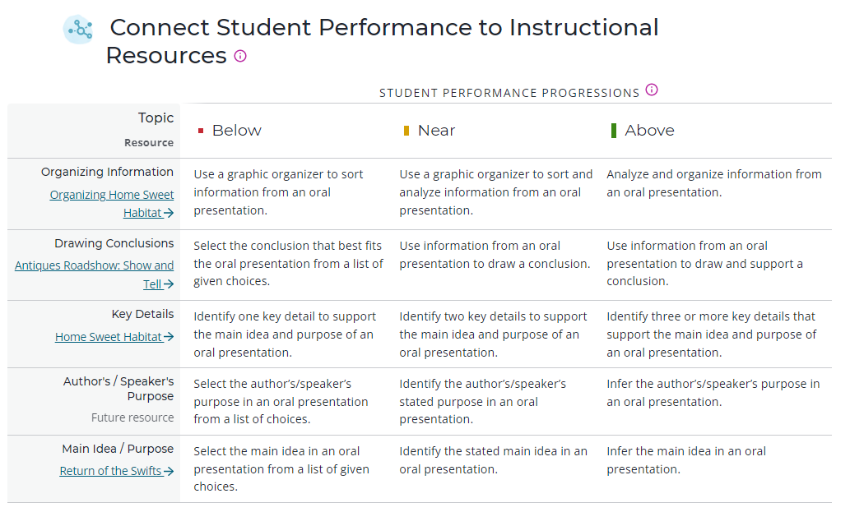
Using a Connections Playlist
Playlist suggests instructional next steps with links to example materials by performance level.

Slide 32
Questions?
If you have questions or would like to schedule a classroom demonstration:
Dr. Catherine Matthews
cmatthews@everettsd.org
extension 4058
Quiana Hennigan
    qhennigan@everettsd.org
    extension 4057

